Slide 1
Effect of Object Surfaces and Shapes on Hand Grip Function for Heavy Objects
Presented by:
Cecilia Rose Garza
Texas A&M University-Kingsville
Mentored By:
Dr. James Yang

Slide 2
An Introduction into: Daily Life
“Don't underestimate the power of your vision to change the world. Whether that world is your office, your community, an industry or a global movement, you need to have a core belief that what you contribute can fundamentally change the paradigm or way of thinking about problems.”
-Leroy Hood
Read more at: https://www.brainyquote.com/quotes/quotes/l/leroyhood652766.html?src=t_movement
THINGS TO CONSIDER
Grip Functionality
Rehabilitation Application

Slide 3
Can the application of heavier weighted objects impair the effect of commonly used frictions?
Our Question

Slide 4
What are the manipulations? Where is the data?
Independent Variables
Dependent Variable
Shape
Friction
Subject Performance
Aim is to measure manual growth dexterity.

Slide 5
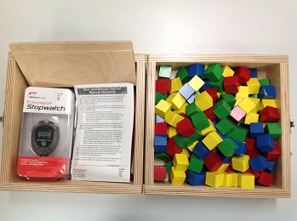
Procedure
Subject comes in to laboratory and provided further instruction prior to experiment.
They sit next to a box quite similar to the photo listed.
They will be timed for a total of 30s per trial and overall take no longer than 30 minutes for entire procedure.
Throughout the trials filming will be taking place at 30 frames for data analysis breakdown of the seven steps of BBT.

Slide 6
What to learn?
WHAT IS THE NEXT STEP?
Varying Factors
Shapes
Weights
Frictions
Subjects
Use actual patients
PRACTICAL IMPLICATIONS
In addition, therapists may vary difficulties by using objects with high-friction or low-friction surfaces to encourage or challenge patients, respectively. Lastly, redesigning daily objects by changing grip surfaces may benefit people with sensorimotor impairment by improving their hand grip function and speed.
{Seo, 2012 #2}

Slide 7
QUESTIONS?

