Slide 1
The effect of restorative environments on sustained attention: a Replication and extension of berto (2005)
Cooper Rodriguez

Slide 2
Background
Nature’s importance to humans
Nature can:
Improve affect/mood (Hartig et. al., 2003)
Reduce physiological and psychological stress (Ulrich et al., 1991)
Improve attention (Kaplan, 1995; Berman, Jonides, & Kaplan 2008; Berto, 2005)
Notes:
Natures importance to humans – build parks, invest in landscaping, fight to preserve natural settings, the focus of artwork, when you go on vacation to “get away” think of a natural location
Empirical evidence has shown that…
Berto

Slide 3
Berto,2005
Experiment 1
Verify if restorative environments could improve performance on an attention task
Finding: Nature improved reaction time compared to urban.
Experiment 2
Determine whether and how geometric shapes will effect performance
Finding: Geometric shapes did not have any performance effects
Experiment 3
Replication of experiment 1, but participants determined how long they would view the images
Finding: performance was not significantly different between nature and urban which was due to participants choosing to not view the pictures as long as in experiment 1.
Notes:
Completed three difference experiments one verifying if restorative environments could improve performance on an attention task, one determining whether and how geometric shapes will affect performance and one allowing participants to determine how long they would view the images.
She found that reaction time was improved in the first experiment, geometric shapes had no effect on performance, and when participants viewed images for less than 15 seconds no performance effects occurred.

Slide 4
Purpose
Replicate and extend Berto (2005)
Can we find the same restorative effects if we remove color from the image?
Notes:
Statistical flaws – Multiple t-test did not use an alpha correction to reduce an increase in family wise error
ANOVA instead
Reaction time was the only variable that expressed a difference between the nature and urban in experiment 1 but during experiment 3 that affect disappeared that so was that due to chance or the restorative effect?
Large body of research on the impact color may have on emotions and large inconsistencies within that body of research so we are interested so this is very exploratory and if we do find an effect we will want to try to replicate it

Slide 5
Question
How will participants’ attention performance on the SART (Sustained Attention to Response Test) change if we greyscale the images presented to participants? Will nature still have a restorative effect on attention performance?
Notes:
I will explain what a SART is shortly

Slide 6
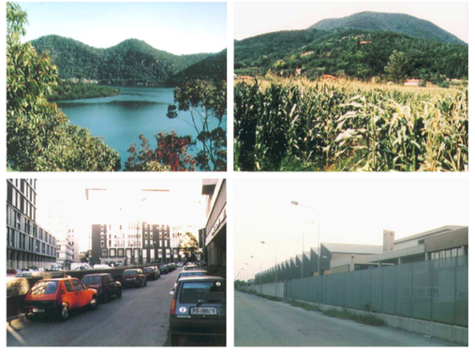
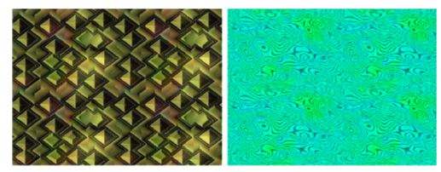
Method
Pre-test post-test
SART (Sustained Attention to Response Test)
Restorative or nonrestorative exposure
Urban original or greyscale
Nature original or greyscale
Control (geometric shapes) original or greyscale
Berto, 2005.
Notes:
SART (Sustained Attention to Response Test) –Requires participants to abstain from responding to the target which is the number 3 while rapidly responding to the non-target which are numbers 1-9. This is done over a 4.3 min period.

Slide 7
Procedure
SART
Intervention
SART
Dependent Variable
Experimental Design
Dependent Variable
d-prime – participant's sensitivity in the detection of the target
Reaction time
Number of correct responses
Number of incorrect responses
Image Type
Nature Urban Geometric
C
O
L
O
R
YES
NO
Notes:
Looking at our procedure you can see… and then going into our experimental design we can see our IV’s – image type & color and then our dv’s are based on the SART performance so
DV – d-prime, RT, IR, CR

Slide 8
Procedure
SART
Intervention
SART
Improved performance defined by
INCREASE d-prime – participant's sensitivity in the detection of the target
DECREASE Reaction time
INCREASE Number of correct responses
DECREASE Number of incorrect responses
Experimental Design
Dependent Variable
Image Type
Nature Urban Geometric
C
O
L
O
R
YES
NO
Performed Better | No Effect | No Effect
Notes:
Looking just at image type these are our expected results – participants will perform better after the nature images and there will be no effect on performance following the urban or geometric images
Improved performance is defined by …

Slide 9
Procedure
SART
Intervention
SART
Improved performance defined by
INCREASE d-prime – participant's sensitivity in the detection of the target
DECREASE Reaction time
INCREASE Number of correct responses
DECREASE Number of incorrect responses
Dependent Variable
Experimental Design
Image Type
Nature Urban Geometric
C
O
L
O
R
YES
NO
Improved performance | No effect | No effect
 | ← Exploratory →
Notes:
Looking just at color with color is basically the replication of Berto so our expected results are the same as the previous slide
But without color is what we are exploring so will the restorative affect be lost or can participants still imagine the color and attention performance still improve?

Slide 10
Procedure
SART
Intervention
SART
Improved performance defined by
INCREASE d-prime – participant's sensitivity in the detection of the target
DECREASE Reaction time
INCREASE Number of correct responses
DECREASE Number of incorrect responses
Dependent Variable
Experimental Design
Image Type
Nature Urban Geometric
C
O
L
O
R
YES
NO
Performed better | No effect | No effect
Exploratory | Exploratory | Exploratory
Notes:
When we look at both image type and color
If color enhances restoration, then we would expect nature with color to result in the most improvements and urban without color to result in the least improvements.
But still exploratory unsure of what will occur without color

Slide 11
Practical Application
UN predicts by 2050 70% of the worlds population will live in an urban setting
Study breaks on campus (Felsten, 2009)
Recovery from surgery (Ulrich, 1984)
Interior design for improving wellness (Ulrich, 1991)
Baggage screening, air traffic controller, and additional applied vigilance tasks

Slide 12
Questions?
Notes:
Operationally define – Kaplan has his theory and came up with 4 components that are necessary for an environment to be restorative & restoration – nature is innately captivating our indirect attention which frees up our direct attention and that results in improved cognition & there are alternative theories
Underlying mechanism – 1. evolutionary response- evolved to have a preference for nature because it has what we need to survive 2. Learned preference because vacations are typically in naturally environments

