Slide 1
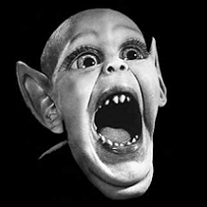
Can the science of induction save us from the next bat epidemic?
Cognitive science matters for public health

Slide 2
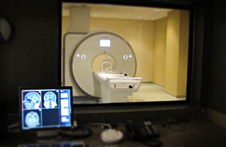
My Lab
Categories and concepts
  How do we learn to group objects to facilitate generalization?
  How does this grouping impact reasoning, memory, and judgments of typicality?
Neuroscience-based approach

Slide 3
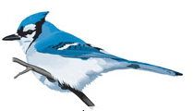
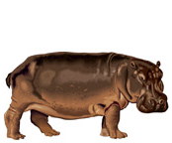
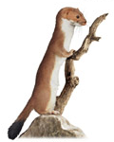
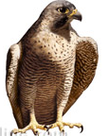
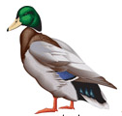
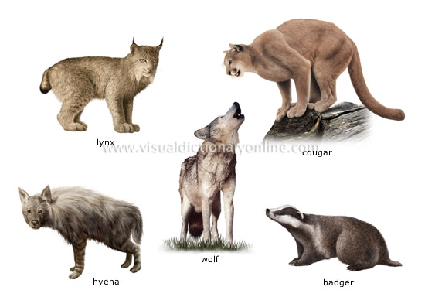
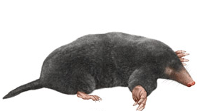
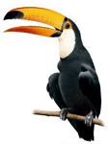
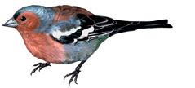
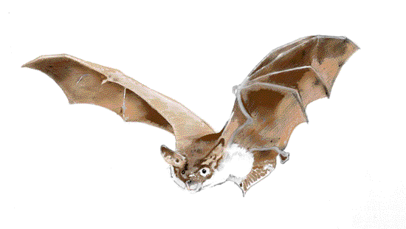
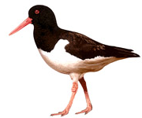
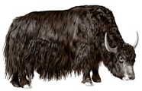
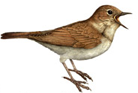
Exception Learning

Slide 4
Exception Learning

Slide 5
Exception Learning

Slide 6
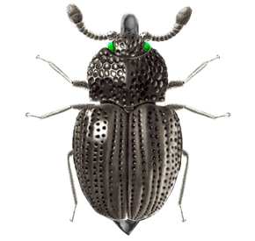
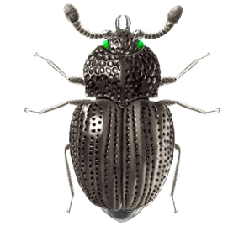
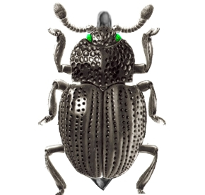
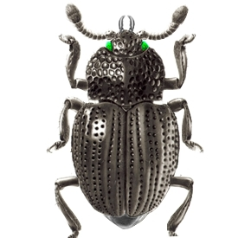
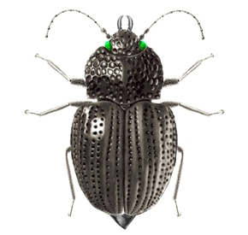
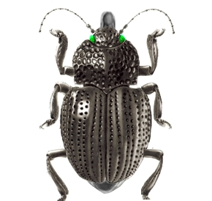
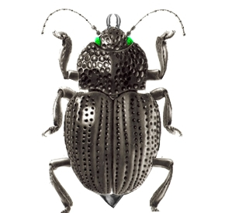

Category Structure
Hole 1
Hole 2

Slide 7
Category Structure
Hole 1
Hole 2

Slide 8
Category Structure
Hole 1
Hole 2

Slide 9
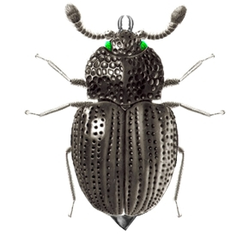
Experiment
Hole 1 or Hole 2?

Slide 10
Experiment
Incorrect, this one
Lives in Hole 2

Slide 11
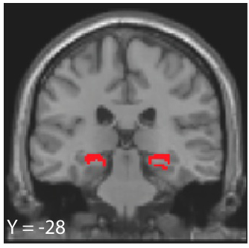
Memory Strength Results
Memory Strength
Trial Number
Exception
FDR Corrected p< 0.05
Rule-following item

Slide 12
Many projects looking at exceptions
Davis, Love, and Maddox (2009a) Memory & Cognition
    Exceptions are difficult to individuate when they continuous features
Davis, Love, and Maddox (2009b) Cognition
    Exceptions elicit orienting responses (SCR) but only after well-learned
Davis, Love, and Maddox (2012) Learning & Memory
    Older adults are impaired at learning exceptions
Davis, Love, and Preston (2012a) Cerebral Cortex
    MTL activates more for exceptions
Davis, Love, and Preston (2012b) JEP:LMC
    Conflict/uncertainty associated with exceptions activates a different sub region of MTL
Davis, Xue, Love, Preston, and Poldrack (2014) J Neuroscie
    Neural similarity space in MTL reflects psychological organization of categories containing exceptions
Every one used the bat analogy

Slide 13
Many projects looking at exceptions
All used the bat analogy
Davis, Love, and Maddox (2009a) Memory & Cognition
    Exceptions are difficult to individuate when they continuous features
Davis, Love, and Maddox (2009b) Cognition
    Exceptions elicit orienting responses (SCR) but only after well-learned
Davis, Love, and Maddox (2012) Learning & Memory
    Older adults are impaired at learning exceptions
Davis, Love, and Preston (2012a) Cerebral Cortex
    MTL activates more for exceptions
Davis, Love, and Preston (2012b) JEP:LMC
    Conflict/uncertainty associated with exceptions activates a different sub region of MTL
Davis, Xue, Love, Preston, and Poldrack (2014) J Neuroscie
    Neural similarity space in MTL reflects psychological organization of categories containing exceptions
Every one used the bat analogy

Slide 14
Am I a bat expert?
Dear Dr. Davis,
We have learned of your published research on bats. We would like to invite you to participate in our publishing program. In particular, we have in mind a new research or review article for a hardcover edited collection (by selected invitation only) tentatively entitled:
Bats: Phylogeny and Evolutionary Insights, Conservation Strategies and Role in Disease Transmission

Slide 15
Does exception work generalize?
Two things I wondered from the email:
  Does exception work generalize to actual bats?
    Or just about a particular (artificial) feature distribution?

Slide 16
Does exception work generalize?
Two things I wondered from the email:
  Does exception work generalize to actual bats?
    Just about a particular (artificial) feature distribution?
  Does anyone in psychology really know how people reason about bats?

Slide 17
Understanding Bats
Why Bats are important:
  Reservoirs for medically significant zoonoses:
    Ebola, rabies, Nipah, Hendra, Marburg, etc.
  Bats play a critical role in ecosystems and disease prevention
    Regulate mosquito populations
    Pollinators:
      Cocoa, durian, mango, banana, guava, agave, etc.

Slide 18
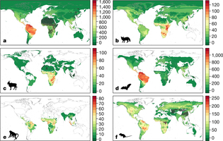
Recent Nature Paper (Olival, et al. 2017)
Bats carry more zoonoses than other animals
Researchers estimate up to 17 new zoonoses yet to be discovered in bats
New regional pandemic risk is driven by bats

Slide 19
Inductive Reasoning
Inductive generalizations
  X is known to have property Y, how likely is Z to also have property Y?
Inductive generalizations to/from bats?
  Bats are atypical and exceptions
  Using bird knowledge on bats can be very bad:
    Impact of wind farms

Slide 20
Category Typicality Effects
Which is the stronger argument?
  (A) Bats have an aortic arch therefore all mammals have an aortic arch
  (B) Dogs have an aortic arch therefore all mammals have an aortic arch

Slide 21
Category Typicality Effects
Which is the stronger argument?
  (A) Bats have an aortic arch therefore all mammals have an aortic arch
  (B) Dogs have an aortic arch therefore all mammals have an aortic arch
    Generally people pick B
  Is being an exception different from atypicality?
    Inductive support to/from other categories?

Slide 22
Study 1
Q1 Are bats treated like atypical category members?
  Lower generalization from bats to other mammals (and vice versa)

Slide 23
Study 1
Q1 Are bats treated like atypical category members?
  Lower generalization from bats to other mammals (and vice versa)
Q2 Are bats not merely atypical but also treated like the category they resemble?
  Greater generalization of facts from birds to bats (and vice versa)?

Slide 24
Study 1
Q1 Are bats treated like atypical category members?
  Lower generalization from bats to other mammals (and vice versa)
Q2 Are bats not merely atypical but also treated like the category they resemble?
  Greater generalization of facts from birds to bats (and vice versa)?
Q3 Do people differ in generalization of internal and external traits across categories (birds and mammals)?

Slide 25
Experiment
Four premise categories:
  Hedgehog, bat, mammals, and birds
Conclusion categories:
  Dog, robin, bat, and ostrich
External: “Imagine that scientists discover a new feeding behavior, plankalating, in mammals. How probable (1-100) is it that this behavior occurs in:”
Internal: “Imagine that scientists discover a new protein, frombalamin, in mammals. How probable (1-100) is it that this protein will be found in:”

Slide 26
Bats vs Hedgehogs (External)

Slide 27
Bats vs Hedgehogs (Internal)

Slide 28
Mammals and Birds (External)

Slide 29
Birds Mammals (Internal)

Slide 30
Robins vs Ostriches (external)

Slide 31
Robins vs Ostriches (Internal)

Slide 32
Conclusions study 1
People don’t reason effectively about bats!
  Generalize bat traits to birds more often than other common mammals
  Generalize bird traits to bats more often than other common mammals
  Occurs for both external and internal characteristics
  Bats are not just atypical exemplars

Slide 33
Is it fundable?
Armed with these facts, I immediately asked someone in public health whether they thought we could get $$$ for it…
  “No. We need actionable public health data.”
Does induction impact health behaviors?
  Intentions to report animal bites
  Consumption of wild game meat
  Other interactions with animals?

Slide 34
Health Psych of Animal Bites?
Bingham, Budke & Slater (2010) Prev vet med
  People are more likely to intend to report a dog bite if they know people can get rabies from a bat
  Nearly all participants knew that dogs could transmit rabies
P-hacked with step-wise regression
  But what does it mean if it is true?

Slide 35
Premise number
Which is stronger?
  (A) Hawks, sparrows and eagles have sesamoid bones. Therefore all birds have sesamoid bones.
  (B) Hawks and sparrows have sesamoid bones. Therefore all birds have sesamoid bones.

Slide 36
Premise number
Which is stronger?
  (A) Hawks, sparrows and eagles have sesamoid bones. Therefore all birds have sesamoid bones.
  (B) Hawks and sparrows have sesamoid bones. Therefore all birds have sesamoid bones.
People tend to say A because of premise number
Does knowing bats and dogs can transmit rabies increase perceived likelihood of human transmission?

Slide 37
Premise diversity effects
Which is the stronger?
  (A) Lions and tigers use norepinephrine as a neurotransmitter. Therefore rabbits use norepinephrine as a neurotransmitter.
  (B) Lions and giraffes use norepinephrine as a neurotransmitter. Therefore rabbits use norepinephrine as a neurotransmitter.

Slide 38
Premise diversity effects
Which is the stronger?
  (A) Lions and tigers use norepinephrine as a neurotransmitter. Therefore rabbits use norepinephrine as a neurotransmitter.
  (B) Lions and giraffes use norepinephrine as a neurotransmitter. Therefore rabbits use norepinephrine as a neurotransmitter.
People tend to say B because of premise diversity
Does knowing bats and dogs can transmit rabies increase perceived likelihood of human transmission?

Slide 39
Study 2
Replicate and extend the Bingham et al. bite reporting effect
  “Novel disease that infects liver cells” instead of rabies to preclude background knowledge
  Ask about disease transmission to and from a number of mammals and birds
  Ask for bite reporting for a range of mammals and birds
    Do individual differences in bite reporting correlate with number/strength of beliefs about cross-species disease transmission?

Slide 40
Bite Reporting
“How likely would you be to report being bitten by the following animals to a health professional (1-100):”
  Dog, skunk, monkey, bat, and squirrel
  Blue jay, robin, swan, grackle, and peacock

Slide 41
Bite Reporting
“Scientists discover that a new disease can infect the liver tissue of x. How likely is it this disease can infect the following animals:”
  Premise (x) animals: dog, skunk, monkey, bat, blue jay, grackle, swan, and peacock
  Conclusion animals: Dog, skunk, monkey, bat, squirrel, blue jay, robin, swan, grackle, and peacock

Slide 42
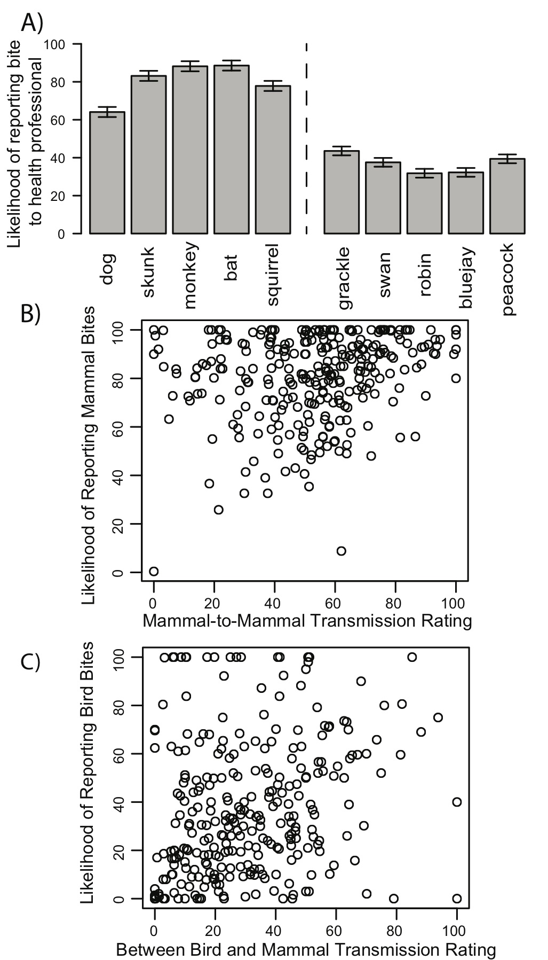
Bite Reporting Intentions

Slide 43
Mammal Bite Reporting

Slide 44
Bird Bite Reporting

Slide 45
Species-to-species disease trans (mammals)

Slide 46
Species-to-species disease trans (birds)

Slide 47
Discussion
People who endorse more cross-species disease transmission are more likely to report bites
  Consistent with premise diversity and number
Just an individual difference effect?
  Work on disgust/contagion in social psych suggests individual differences in disgust to animality

Slide 48
Study 3
Use Ebola communications from CDC and WHO
Experimentally manipulate premise diversity
  Ratings of likelihood of Ebola susceptibility, bite reporting, and likelihood of consuming game meat for each animal

Slide 49
CDC Condition
CDC Wording Condition (Not Diverse)
“The Ebola virus causes an acute, serious illness which is often fatal if untreated. Ebola virus disease (EVD) first appeared in 1976 in 2 simultaneous outbreaks, one in what is now, Nzara, South Sudan, and the other in Yambuku, Democratic Republic of Congo. The latter occurred in a village near the Ebola River, from which the disease takes its name. Ebola is introduced into the human population through close contact with the blood, secretions, organs, or other bodily fluids of infected animals such as fruit bats, gorillas, monkeys, and chimpanzees. “

Slide 50
WHO Condition
WHO Wording Condition (Diverse)
“The Ebola virus causes an acute, serious illness which is often fatal if untreated. Ebola virus disease (EVD) first appeared in 1976 in 2 simultaneous outbreaks, one in what is now, Nzara, South Sudan, and the other in Yambuku, Democratic Republic of Congo. The latter occurred in a village near the Ebola River, from which the disease takes its name. Ebola is introduced into the human population through close contact with the blood, secretions, organs, or other bodily fluids of infected animals such as fruit bats, monkeys, forest antelope, and porcupines. “

Slide 51
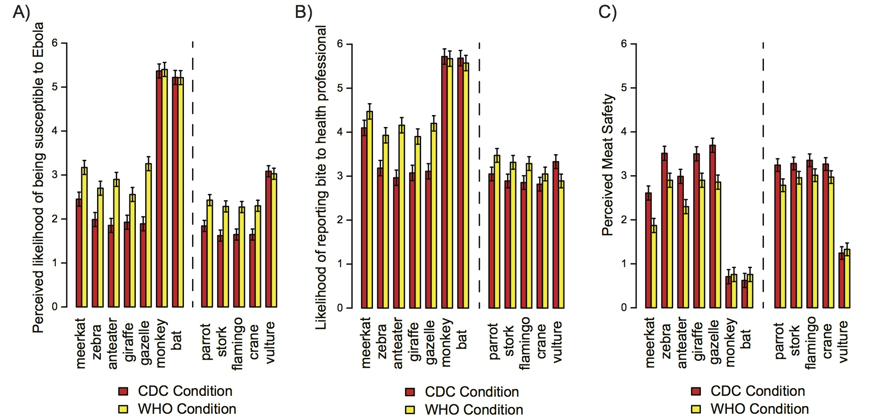
Perceptions of Ebola Sensitivity

Slide 52
Bite Reporting

Slide 53
Meat Safety

Slide 54
Discussion
Premise diversity impacts people’s health behaviors associated with zoonosis risk:
  Communications should more effectively describe range of species susceptible to a disease
  Inductive reasoning principles play a critical role in reasoning about health risks

Slide 55
Limitations of Ebola study
The sample, for the most part, was not at risk for Ebola
  Primarily western sample, higher education

Slide 56
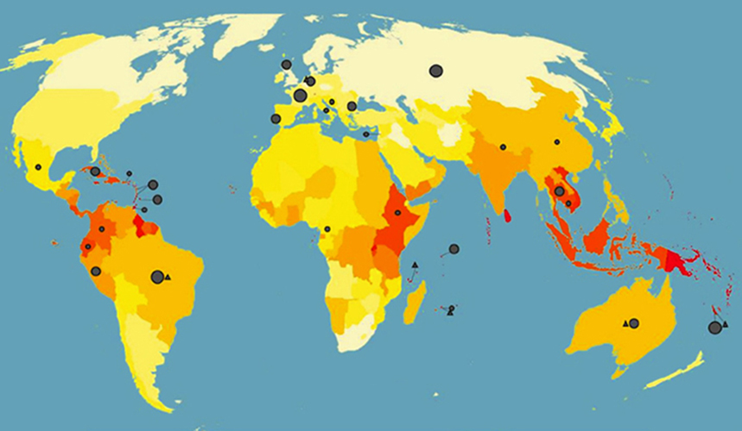
Leptospirosis Study
Leptospirosis is a bacterial zoonosis with global impact
  Recent outbreak in the Bronx
  Impacts kidneys, brain, and liver
Human transmission from farm animals, wild animals, pets, rats (most mammals) via urine

Slide 57
Premise-conclusion similarity
As a further extension we manipulated premise-conclusion similarity
  Premises should generalize better to conclusions they are similar to
Which is stronger?
  Lions metabolize vitamin k therefore tigers metabolize vitamin k
  Lions metabolize vitamin k therefore gazelles metabolize vitamin k

Slide 58
Premise-conclusion similarity
As a further extension we manipulated premise-conclusion similarity
  Premises should generalize better to conclusions they are similar to
Which is stronger?
  Lions metabolize vitamin k therefore tigers metabolize vitamin k
  Lions metabolize vitamin k therefore gazelles metabolize vitamin k

Slide 59
Design
Participants are given a list of susceptible farm or forest animals (between subjects)
  Generalization to new farm or forest animals?

Slide 60
Lepto Instructions
Leptospirosis is a bacterial disease that affects both humans and animals. Humans become infected through direct contact with the urine of infected animals or with a urine-contaminated environment. The bacteria enter the body through cuts or abrasions on the skin, or through the mucous membranes of the mouth, nose and eyes. Mammals can harbour the bacteria that cause leptospirosis in their kidneys and genital tracts and act as source of infection to humans and other animals. Many mammals can be a reservoirs for human infection, including:
C1: Rats, Raccoons, and Deer
C2: Pigs, Cattle, and Horses.
Test animals: Rabbit, Opossum, Skunk, Sheep, Donkey, Goat, Dog

Slide 61
Lepto Generalization

Slide 62
Safety of Interacting with Animal

Slide 63
How safe is it to swim near habitat?

Slide 64
Discussion
Inductive principles influence leptospirosis susceptibility judgments and perceptions of safety of interacting with animals
Susceptibility ratings for farm animals and forest animals were both higher for prompts with similar animals
For interactions, mostly farm animals were influenced by manipulations
  Perhaps people already consider wild animal interaction mostly unsafe

Slide 65
General Discussion
Can the science of induction save us from the next bat epidemic?
  Results suggest that inductive principles impact health behaviors related to drivers of zoonoses
  Somewhat mutable:
    Premise diversity effects seem to work
    Similarity-based generalization also consistent with inductive models

Slide 66
Implications
Health communications and interventions need to pay attention to inductive principles
  All is takes is one person thinking a bat is just a furry bird!
  Reducing probability of contact with disease reservoirs will have an impact on emerging zoonosis

Slide 67
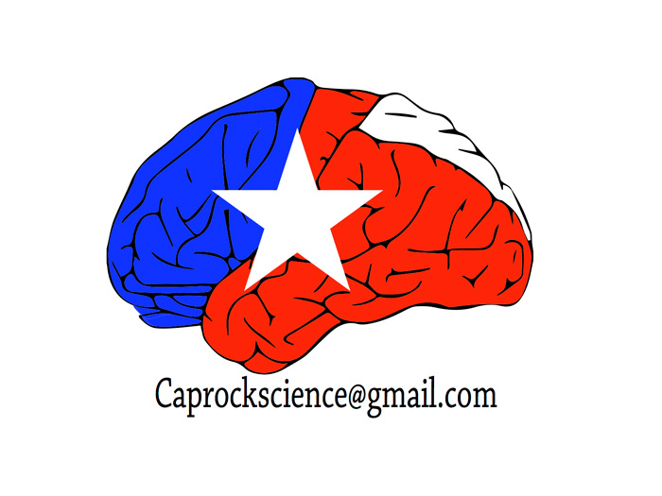
Thanks
CAPROCK Lab:
  Nathan Tapp (now post doc @ Auburn)
Collaborators:
  Micah Goldwater (U Syd)
  Nick Gaylord (CrowdFlower)
  Molly Ireland (TTU Psych)
  Jason Van Allen (TTU Psych
  Darrell Worthy (TAMU)
  Ross Otto (McGill)
  Brian Glass (Oregon Government)

