Slide 1
How to Build Effective PSAs: A Biopsychological Model of Message Processing
Zachary P. Hohman
Texas Tech University

Slide 2
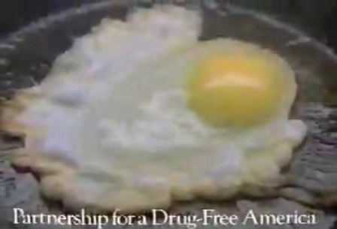
Drug Abuse
Attempts to reduce drug use by Federal agencies include:
  Drug Abuse Resistance Education program (DARE)
  The National Youth Anti-Drug Media Campaign (NYAMC)
  Other PSAs
At best these effort and others are ineffective¹
  At worst some are associated with increased use²
¹Margura, 2012; ²Werch & Owen, 2002
2

Slide 3
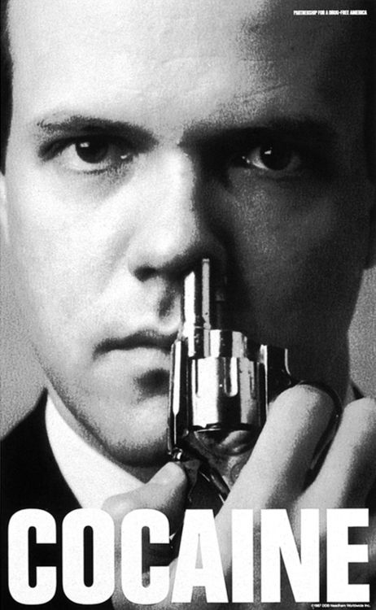
Problems With PSA
Limiting Factor of PSAs
  Lack of consideration to the structure of the message
    What information is presented
    When that information is presented
    How is the message/information presented
    How the viewer interacts with the message
3

Slide 4
What Information is Presented: Attitudes
Psychologists have long been at odds over the relationship between attitudes and behaviors.^{1,2,3}
  Attitudes can affect actions, but a number of variables moderate the attitude-behavior relation.^{4,5,6,7,8,9,10}
^{1,2}Crano & Prislin, 2006, 2008; ³McGuire, 1985; ⁴Ajzen & Fishbein, 1977; ⁵Cacioppo, Gardner, & Berntson, 1997; ⁶Crano, 2012; ⁷Fishbein & Ajzen, 1975; ⁸Petty & Krosnick, 1995; ^{9,10}Priester & Petty, 1996, 2001
4

Slide 5

Attitude Ambivalence
Attitude ambivalence is when people hold both positive and negative feelings about an object concurrently¹
  Being ambivalent is aversive and motivates people to reduce the ambivalence²
¹Priester & Petty, 1996, 2001, ²Preister, 2002
5

Slide 6
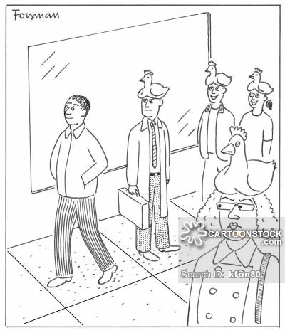
Social Norms
People use social groups to learn about what to think and how to behave in different situations.¹
Attitudes are important an feature of group life²
  Individuals should look to their groups to determine the correct attitudes in circumstances of high ambivalence.
¹Tajfel & Turner, 1979; ²Hogg, 2012
6

Slide 7
Social Norms
        Hypothesis
  When attitudinally ambivalent about marijuana use, adolescents' marijuana use will be influenced by their friends’ norms about marijuana.
  Used data from the National Survey of Parents and Youth (NSPY) to test hypothesis
7

Slide 8
Ambivalence – Round 1
  “How likely is it that the following would happen to you if you used marijuana, even once or twice, over the next 12 months, I would …
  1. Upset my parents?
  2. Get in trouble with the law?
  3. Lose control of myself?
  4. Start using stronger drugs?
  5. Be more relaxed?
  6. Have a good time with my friends?
  7. Feel better?
  8. Be like the coolest kids?”
  1 (very unlikely) to 5 (very likely)
  The first four items were recoded so that higher scores indicated positive beliefs about marijuana use.
  A standard deviation was computed across all eight items¹
¹Hohman, Crano, Alvaro, & Siegel, 2014 – Prevention Science
8

Slide 9
Norms and Behavior
Friend Norms – Round 1
  “How do you think your close friends would feel about you using marijuana even once or twice over the next 12 months.”
  “When it comes to drug use, I want to do what my close friends want me to do.”
Behavior - Round 2
  Self-reported marijuana use in the previous year.
9

Slide 10
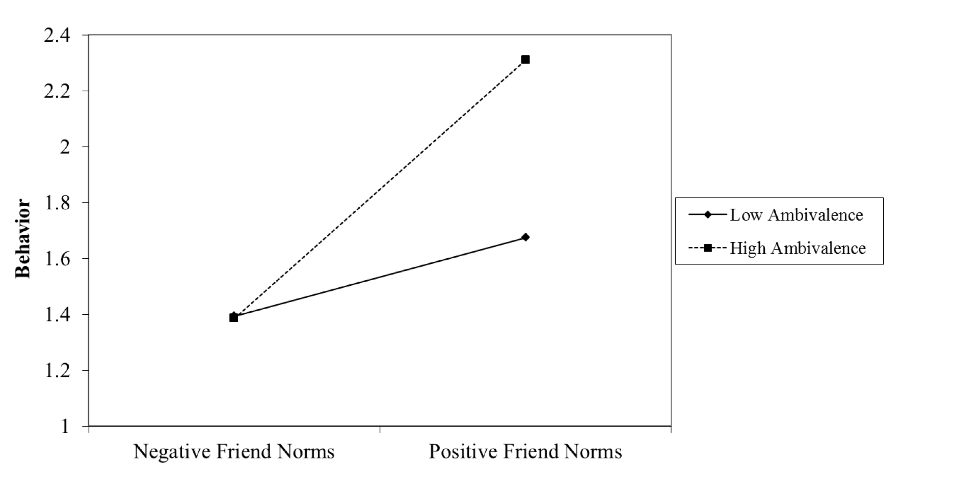
p < .001
p = .13
AmbivalenceXNorm, β = .07, p = .01; N = 1,604
10

Slide 11
Ambivalence Study 2
Determine the causal relationship between attitude ambivalence and social norms on health-related attitudes and behavioral intentions.¹
¹ Hohman, Crano, & Niedbala, 2016 – Psychology of Additive Behavior
11

Slide 12
Methods
Participants were 75 female and 77 male participants (M_{age} = 19.60 years, SD = 3.34 years).
Attitude Ambivalence manipulated
Social Norms manipulated
Attitude change from pre-test to post-test measured
Behavioral intentions measured
12

Slide 13
Ambivalence Manipulation
Ambivalent condition
  Read a persuasive essay that detailed the positive and negative aspects of tobacco use.
Univalent condition
  Read a persuasive essay that detailed only the negative aspects of tobacco use.
13

Slide 14
Social Norm Manipulation
Social norm condition
  “Results of a recent study at Texas Tech University found that only 9% of students approve of tobacco use. The goal of this message is to convince students that they should continue to hold a negative view of tobacco use.”
No norm condition
  “Results of a recent study at Texas Tech University found that students do not have an opinion about tobacco use. The goal of this message is to convince students that they should hold a negative view of tobacco use.”
14

Slide 15
Results – Attitude Change
2-way interaction, F(1, 147) = 5.88, p = .017, η_{p}² = .038
15

Slide 16
Results - Intentions
2-way interaction, F(1, 147) = 6.67, p = .011, η_{p}² = .043
16

Slide 17
Discussion
Taken together this research suggests that:
  Increasing ambivalence makes people more persuadable
  People high in ambivalence will use social norms to reduce ambivalence
  We can use this in our prevention techniques, i.e., PSAs
17

Slide 18
LC4MP
To capitalize on ambivalence and social norms:
  We need to understand how people process anti-drug PSAs
  We need to understand what aspects of PSAs can be manipulated to invoke attitude ambivalence and provide social norms.
One of the most influential and complete understandings of human processing and memory is presented in the Limited Capacity Model of Motivated Mediated Message Processing(LC4MP)¹
¹ Lang, 2009
18

Slide 19

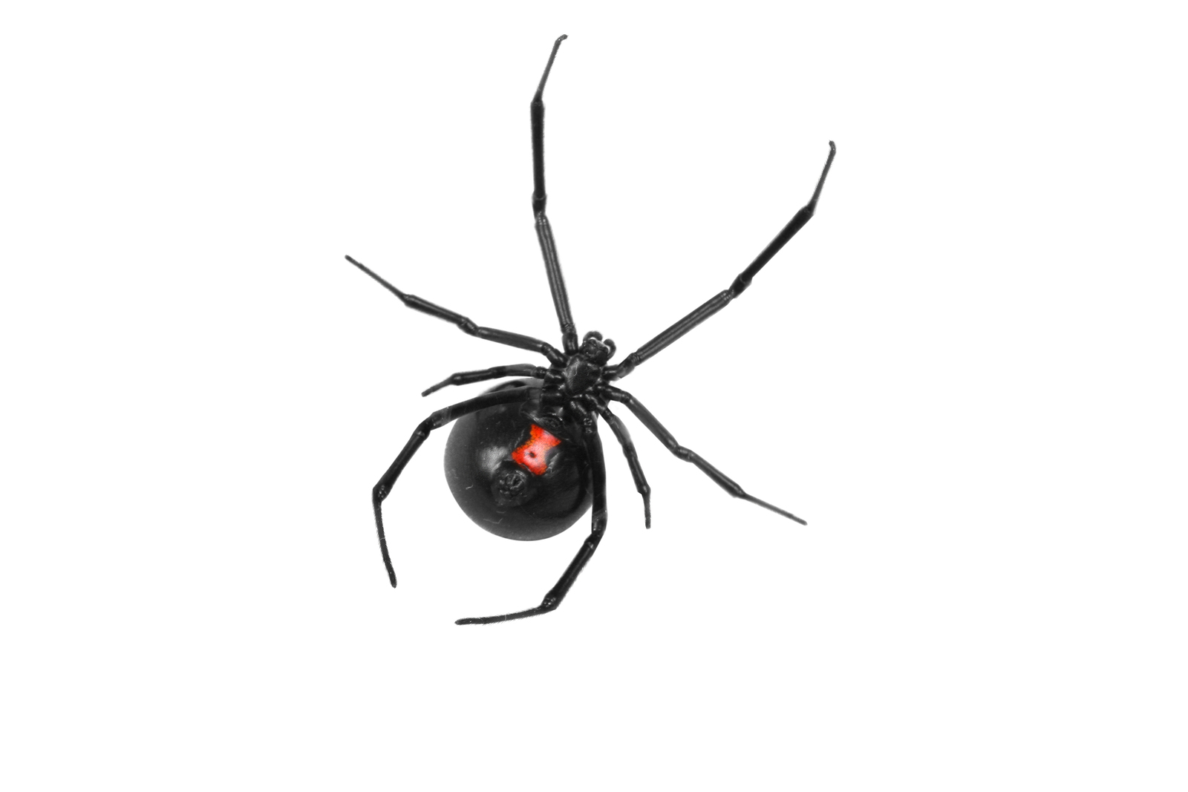
LC4MP
The LC4MP is a theoretical perspective that combines a dimensional theory of emotion,¹ a dual motivational systems model,² and a limited capacity information processing model to explain motivated processing of mediated messages.
  Appetitive System
  Aversive System
¹Bradley et al., 2001; ²Cacioppo & Gardner, 1999
19
Notes:
The appetitive system is built to respond automatically to positive stimuli (food, sex), and is the driving force behind approach behavior.¹
The aversive system responds automatically to potential threats in the environment by
fast acting automatic defensive behaviors (e.g. the startle reflex and the defensive reflex)
motivating complex behaviors like caution, fight, and flight.¹

Slide 20

LC4MP
Appetitive activation results in the automatic allocation of resources to encoding and storage
  results in increasing memory for messages¹
Aversive activation follows the inverted U function
  low to moderate levels of aversive activation resources will be allocated to information intake,
  high levels of activation resources shift towards avoiding or mitigating the threat (e.g. counter arguing, defensive processing, etc.) ¹
¹Lang et al., 2006
20

Slide 21
LC4MP
Messages that elicit this co-activation in the motivational systems have been shown to receive greater resource allocation—resulting in better memory—than messages that are singly valent.^{1, 2, 3}
Messages that elicit activation in both the appetitive and the aversive system are simultaneously likely also to elicit ambivalence in the viewer.
¹Keene & Lang, 2012a; ²Keene & Lang, 2012b; ³Lang et al, 2013
21

Slide 22
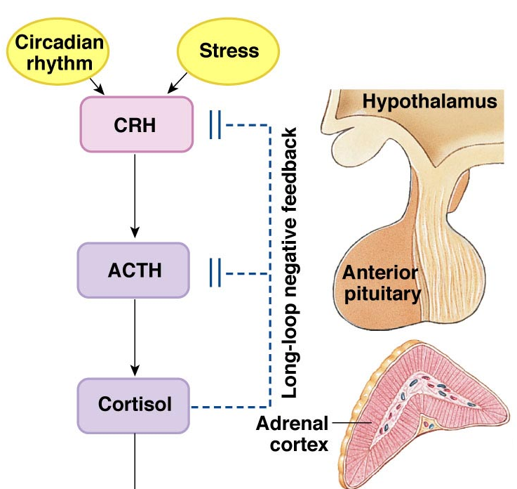
Physiological Stress Responses
Responds in minutes
Glucocorticoids – Cortisol
Notes:
This is the sympathoadrenomedullary system and this is the result of the sympathetic nervous system. This response responds within seconds and is marked by an increase in epinephrine and norepinephrine. This is that adrenaline rush that you feel at the onset of stress.
The second major physiological stress response is one that you might be less familiar with, but this is the hypothalamic pituitary adrenal (HPA) axis. This axis responds within minutes of the onset of a stressor (usually 3-10, depending on the species) and is marked by an increase in circulating glucocorticoids.

Slide 23
Stress
Activation of the HPA axis
↑ Cortisol
Cardiovascular system
Immune system
Metabolic regulation
Brain - cognitive processing and behavior

Slide 24
BioPSYCHOLOGICAL Model
Evaluative Tension
Co-Presentation of Pleasant and Unpleasant Info
Memory for Social Norm Information
Attitude and Behavior Change
Heart
Rate
Endocrine Arousal
24

Slide 25
Study 3 – Ambivalence And PSA
Determine if activation of pleasant and unpleasant information in PSAs leads to attitude ambivalence
Showed people 1 of 5 potential PSAs
  Only pleasant information
  Only unpleasant information
  Pleasant to Unpleasant
  Unpleasant to Pleasant
  Simultaneous presentation
25

Slide 26
Methods
Measured Ambivalence after watch the PSA
  Using the Felt Ambivalence Scale¹
    “Please identify the amount of conflict your feel when you think about abusing prescription medication”
    “Please identify the amount of mixed feelings you have when you think about abusing prescription medications”
    “How indecisive do you feel when you think about abusing prescription medications”
¹ Priester & Petty, 1996

Slide 27
Results
F(4, 324) = 12.94, p < .001, η_{p}² = .138

Slide 28
Study 4 – Endocrinology Study
Determine if activation of pleasant and unpleasant information in same PSAs leads to increased cortisol.
Participants watched 1 of 5 using same 5 PSAs
Before watching we collected saliva for baseline cortisol levels
20 minutes after watching PSA collected saliva to assess change in cortisol
28

Slide 29
Results
F(4,86) = 2.71, p = .036, η² = .112

Slide 30
Study 5 – Heart RAte Study
Determine if activation of pleasant and unpleasant information in same PSAs leads to physiological arousal.
Participants watched all 5 PSAs
Before and while watching the message we measured heart rate.
    Examined changes in heart rate from baseline
30

Slide 31
Results

Slide 33
Biopsychological Model
Attitude Ambivalence
Co-Presentation of Pleasant and Unpleasant Info
Memory for Social Norm Information
Attitude and Behavior Change
Heart
Rate
Endocrine Arousal
33

Slide 34
Implications and Future Directions
Implications
  Capitalizes on theory and empirical evidence of human thought and physiological processing
  Defines the key elements for effective PSAs
Future Directions
  Test the full model
  Develop PSAs based on the results
  Apply to other drugs and health domains
34

Slide 35
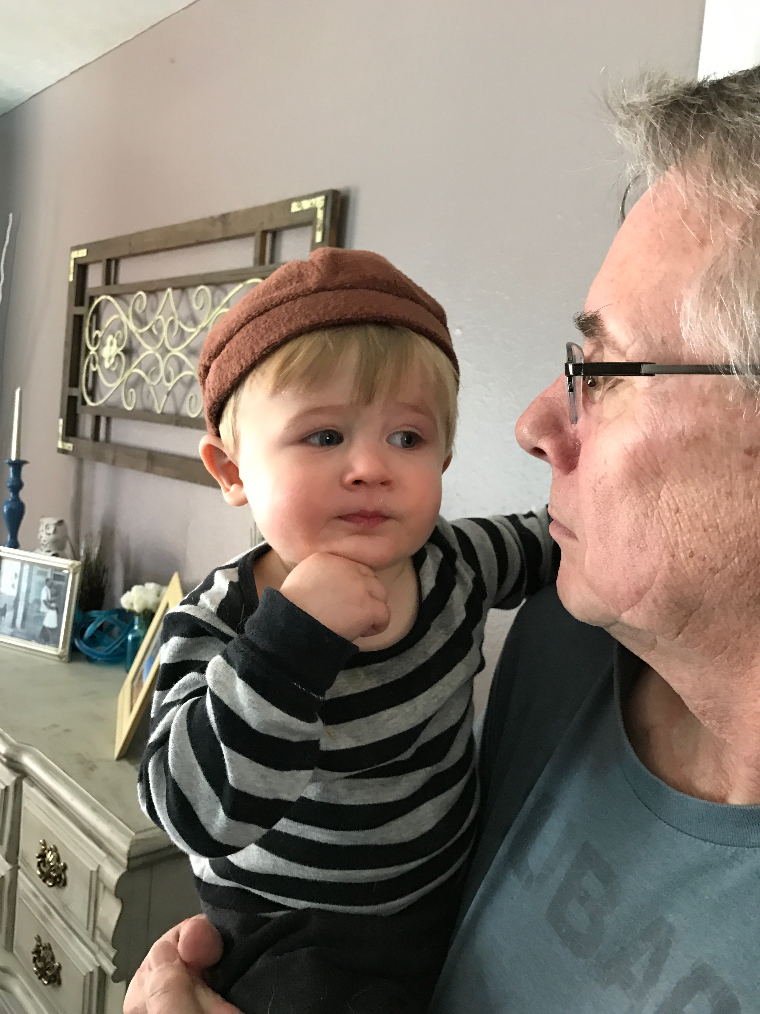
Thanks!
Questions?
35

