Slide 1
Toward Effective Assistive Robots
Keith S. Jones

Slide 2
Robots Are Coming
Pundits expect to find a robot in every home in the future
Gates (2007); Norman (2004)
Personal service robots will assist people with various household chores, or serve as caregivers for the elderly or disabled
Thurn (2004)

Slide 3
Assistive Robots Are Needed
Resident care facilities have space and staffing shortages
Forlizzi, et al (2004)
Thus, greater emphasis has been placed on helping elders live independently in their homes
Forlizzi, et al (2004)

Slide 4
Assistive Robots Are Needed
Keeping elders in their homes solves the space shortage, but not the staffing shortage
Assistive robots could solve the staffing shortage
Safety could also be impacted because most accidents occur while elders are home alone
Living at Home (2002)

Slide 5
Why Do I Care?
People must interact with assistive robots
Widespread adoption of assistive robots will depend on the quality of human-robot interactions
Just as widespread adoption of computers depended on the quality of human-computer interactions
Shneiderman (1998)

Slide 6
How Can I Help?
Psychologists can play two roles
Subject Matter Expert
Conveying what is known about Psychology that is relevant to Human-Robot Interaction
Researcher
Studying interaction with today’s robots
Generating new knowledge about Psychology with the goal of impacting interaction with tomorrow’s robots

Slide 7
What Am I Doing?
Analyzing caregiving in elders’ homes
Enabling caregiver robots that understand a user’s intentions and action-capabilities
Researching whether users understand caregiver robots’ action-capabilities

Slide 8
1: Analyzing Caregiving
This research project seeks to explore and describe how caregiver robots should function by analyzing caregiving in elders' homes, creating a detailed account of current elder care practices, and translating this account into design recommendations for caregiver robots

Slide 9
1: Analyzing Caregiving
Jones, Cherry, Harris, & Sridharan (2017)
Reviewed documentation; Observed caregivers; Interviewing caregivers
Created an Abstraction Hierarchy, which describes relations between the caregiving system’s objectives, work tasks, and physical resources
Confirmed existing research and revealed aspects of caregiving that have not been previously detailed

Slide 10
2: Understanding Users
This research project seeks to enable robots to understand
a) what actions their users intend to perform in the near-future
b) whether their users are capable of safely performing those actions

Slide 11
2a: Understanding Intent
It may be possible to program assistive robots to detect patterns of exploratory behavior in order to know what action an elder wants to do

Slide 12
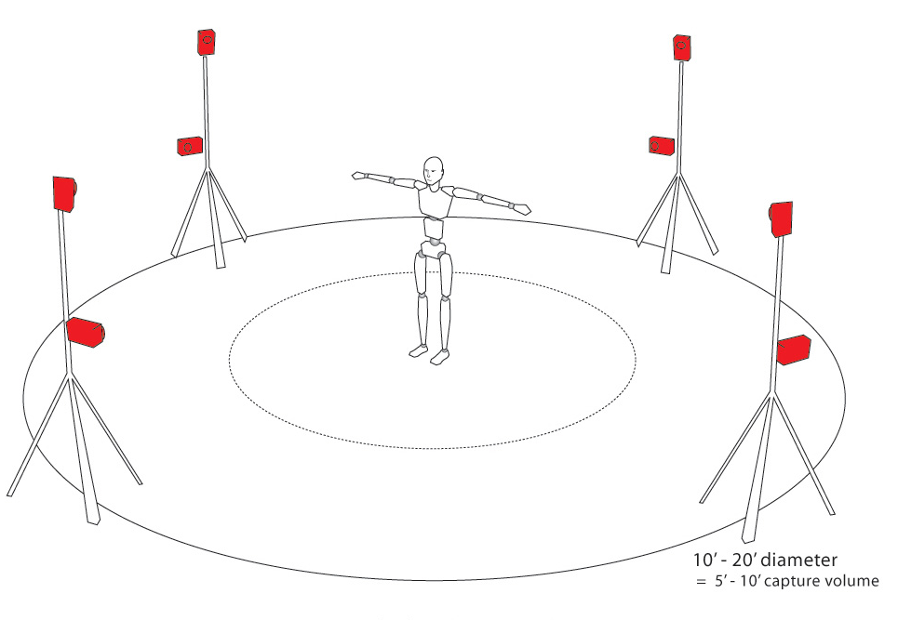
2a: Understanding Intent

Slide 13
2a: Understanding Intent
Jones & Widlus (2017)
Investigated whether exploratory arm movements contribute to reach-ability judgments
Restricting arm movements degraded the accuracy of reach-ability judgments
Next step
Investigate synchronization between head and shoulder movements when the person intends to reach

Slide 14
2b: Understanding Affordances
We know that observer’s base their judgments about an actor’s capabilities on the movements of the other person’s body
Ramenzoni, et al (2008)
Stoffregen, et al (1999)
However, we don’t know which specific movements are critical

Slide 15
2b: Understanding Affordances
Jones & Sridharan (2018)
Will investigate to what do people attend when judging whether another person can jump to reach an object
Point Light Display

Slide 16
3: Understanding Robots
This research project investigates whether users understand their robots’ action-capabilities

Slide 17
3: Understanding Robots
Jones, Schmidlin, & Wheeler (2012)
Investigated whether users could accurately judge the stair-climbing abilities of autonomous, self-balancing, Segway-type robots
Wheeler (2017)
Replicated and extended JSW (2012) with a passively-stable robot

Slide 18
Questions?

