Slide 1
Numeracy and Decision Making
Joselyn Hathaway-Undergraduate Researcher
Michael Serra-Mentor

Slide 2
Purpose
The purpose of this research is to identify:
Numeracy
Factors influencing the numerate and innumerate people
Role in every day life

Slide 3
Background
Numeracy
The ability to understand probability and mathematical concepts
Understanding of representation of numbers
Notes:
Numerate- able to efficiently understand number representation
Innumerate- lower ability to efficiently understand number representation

Slide 4
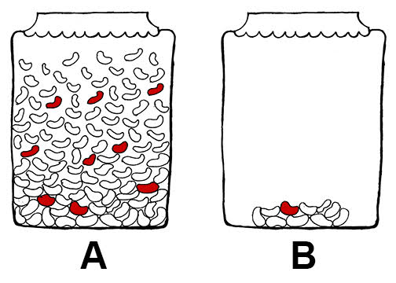
Jar of Jelly Beans Which will you pick for a red jelly bean?
Notes:
Numerate people will pick B due to the chances being higher (understanding representation)
Innumerate people will pick A due to it being more appealing (seeing more)

Slide 5
Questions
What is numeracy?
What role does numeracy play in society and every day life?
How is numeracy part of decision making?

Slide 6
Variables
Participant Variable (non-manipulated)
High vs. low numeracy
Independent Variables
Vary by study
Ex. Positive vs. negative frame
Ex. Frequency vs. percent frame
Dependent Variable
Choices and ratings in risk and decision making task
Reaction time (completion time per task)

Slide 7
Method
Numeracy measures
Lipkus Scale
Berlin Scale
Judgement and decision tasks
Attribute framing (correct vs. incorrect)
Risk representation
Affective information
Affect and Betting
Notes:
Replicating 2 studies
Lipkus- probability, chances, quantitative representation
11 questions
Berlin-judgement, rating scale (test scores)
4 questions
27% incorrect on a test vs. 73% correct on a test

Slide 8
Expected Result
High numerate participants responses will depend on the numerical representation of the questions (replicated results)
Low numerate participants responses will depend on affective information(replicated results)
High numerate people will answer faster(new results)

Slide 9
What Will I learn
Do the affects replicate
Predictability of Lipkus vs. Berlin Scale
Do high and low numerate people differ in reaction time
Notes:
Predictability- how the numerate and innumerate respond to each question

Slide 10
Practical Importance
Low numerate people will make poorer decisions than higher numerate people
Ex. Chances of getting a disease
Improvement of decisions of low numerate people (next step)
Notes:
One person has to test the vaccine with 40% chance of living and everyone lives or one person doesn’t test the vaccine and everyone dies
Assist with making decisions in the real world

