Slide 1
Laparoscopic Skill Acquisition: The need to adapt to disrupted hand-eye mappings
Tina Klein

Slide 2
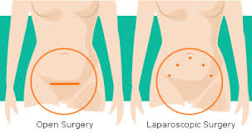
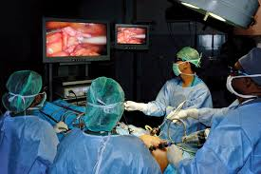
Background: Laparoscopic Surgery
Advantages of laparoscopic surgeries over open surgeries:
Less risk of infection
Faster recovery time
Challenges associated with laparoscopic surgeries
Long learning curves, caused by the perceptual-motor distortions inherent in the laparoscopic environment
Reduced depth information
Reduced haptic information
Disruption of the hand-eye mapping

Slide 3
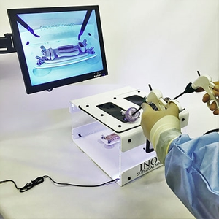
Background: Laparoscopic Surgery
The motto for medical training has been: “see one, do one, teach one”.
This teaching approach is not feasible for laparoscopic skill acquisition.
Laparoscopic simulator

Slide 4
Background: Laparoscopic Surgery
To keep the disruption of the hand-eye mapping at a minimum, the camera is positioned directly in front of the surgeon (if possible) with a downward view onto the target tissue. However, this camera position is not always possible. Sometimes the camera has to be located to the surgeon’s side, increasing the disruption of hand-eye mapping.
The remainder of this presentation will focus on disruptions of hand-eye mapping induced by various camera positions in the laparoscopic training environment.

Slide 5
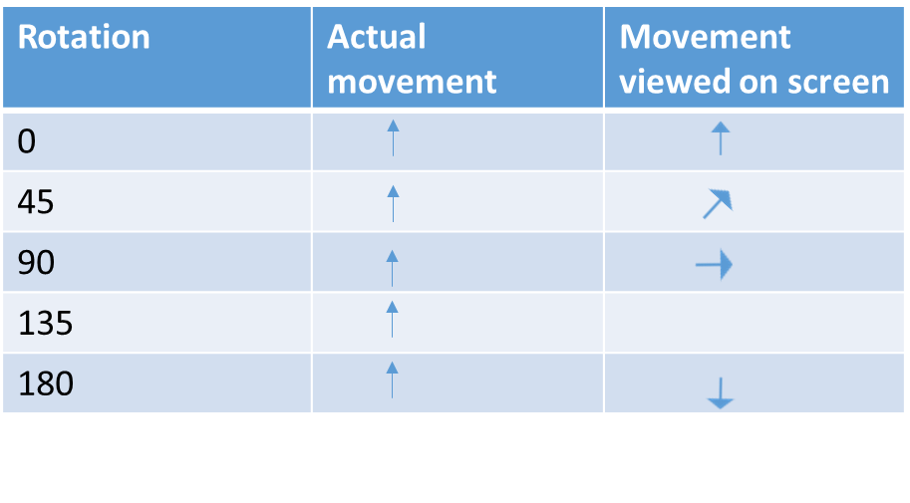
Background: Basic research on disruptions of hand-eye mapping
Cunningham’s (1989) apparatus:
Cunningham (1989):
Participants made pointing movements with a stylus
Participants experienced different degrees of disruptions of hand-eye mapping

Slide 6
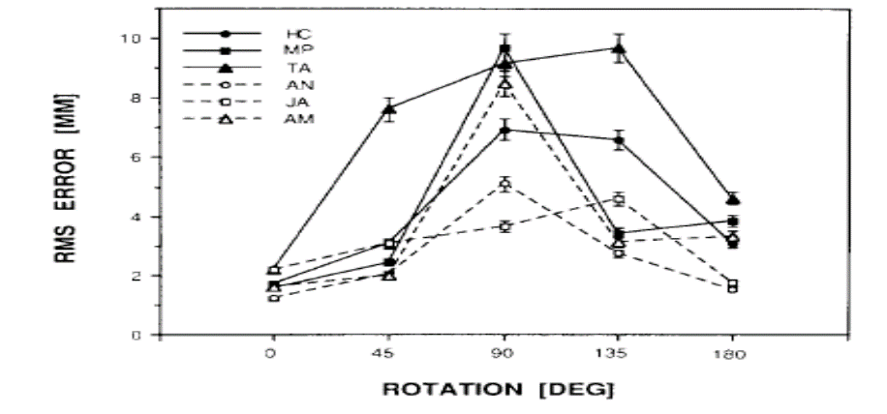
Background: Basic research on disruptions of hand-eye mapping
Hypothesized perceptual-motor adaptation mechanisms:
Gradual adaptation process occurs up to a given threshold
180°: Axis inversion (relatively easy)
For rotations between threshold and 180°: axis inversion +
gradual backward rotation

Slide 7
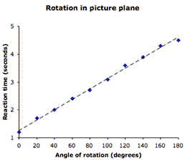
Perceptual-motor adaptation versus mental rotation.
Results by Cunningham (1989)
Results by Shepherd and Metzler, 1971
Adapting to disruptions of hand-eye mappings, like those utilized by Cunningham (1989), are qualitatively different from
performing mental rotations.

Slide 8
How about adapting to sideways camera rotations in the laparoscopic environment? Mental rotation versus perceptual motor adaptation
Medical journals have previously reported that mental rotation skills correlate with laparoscopic skill acquisition (Hedman et al., 2006).
Is performance adaption to disruption of hand-eye mapping in the laparoscopic environment really consistent with mental rotation performance?
If performance adaptation to sideways laparoscopic camera rotations requires mental rotation, performance should get worse as the rotation angle increases, with 180° rotations resulting in worst performance.
If performance adaptation to sideways laparoscopic camera rotations involves the same mechanisms as outlined by Cunningham (1989), than performance at the 180° should be superior than that observed around 90° and 135° rotations.

Slide 9
Some medical journals stated that performing laparoscopies performance involves mental rotation. Is that really the case?
We assessed whether Cunningham’s findings generalize to the laparoscopic training environment (Klein, Wheeler, & Craig, 2015).
Used two tasks:
Pointing task
Peg-transfer task

Slide 10
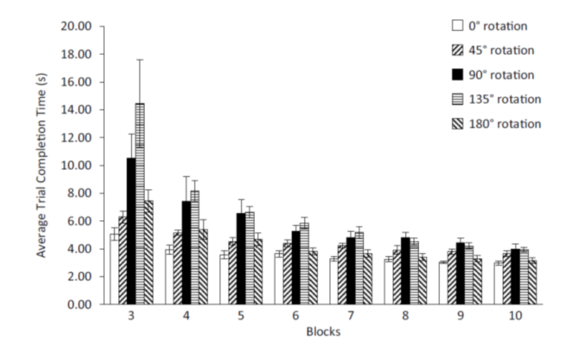
Results by Klein, Wheeler, Craig (2015)
Pointing Task
Peg-Transfer Task

Slide 11
Results by Klein, Wheeler, Craig (2015)
Are the results consistent with perceptual-motor adaption or with mental rotation?
Perceptual-motor adaption

Slide 12
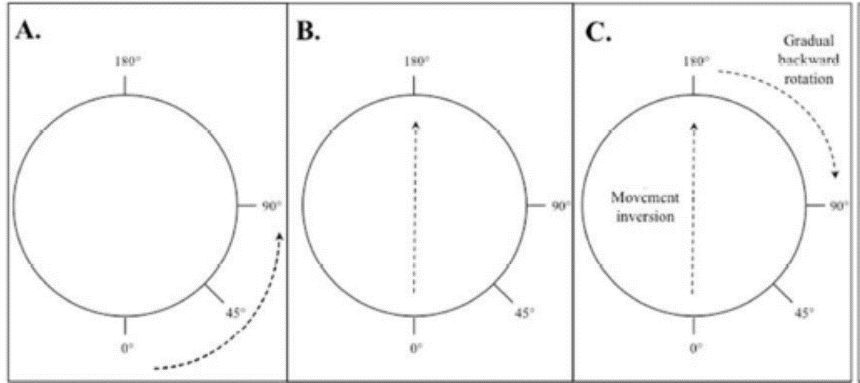
Carry-over effects caused by subsequent camera rotations in the laparoscopic training environment.
Hypothesized perceptual-motor adaptation mechanisms:
Is performance at the second camera rotation
facilitated when both the first and the second rotation use the same perceptual-motor adaptation mechanisms?
How is performance impacted when the first and second camera rotation use different perceptual-motor adaptation mechanisms?
Gradual adaptation process occurs up to a given threshold
180°: Axis inversion (relatively easy)
For rotations between threshold and 180°: axis inversion +
gradual backward rotation

Slide 13
Background on carry-over effects
Abeele and Bock 2001:
Participants performed a computerized joystick tracking task
Participants were assigned to one of eight groups. Each group experienced two rotations (initial rotation and a subsequent rotation).
Results:
150
Group | Initial Rotation | Subsequent Rotations
 | 45° Increasing Rotations
Group 1 | 45 | 90
Group 2 | 75 | 120
Group 3 | 105 | 150
Group 4 | 135 | 180
 | 45° Decreasing Rotations
Group 5 | 90 | 45
Group 6 | 120 | 75
Group 7 | 150 | 105
Group 8 | 180 | 135

Slide 14
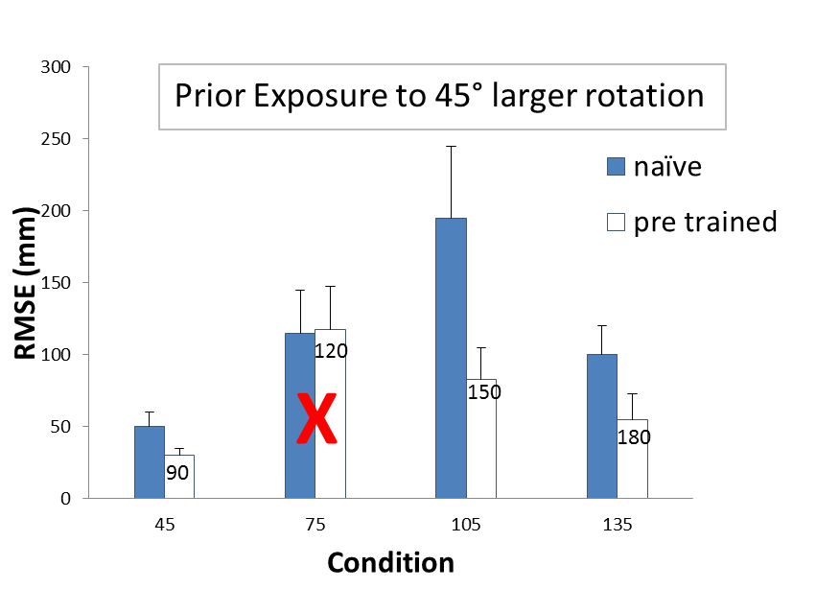
Background on carry-over effects
Abeele and Bock 2001:
Participants performed a computerized joystick tracking task
Participants were assigned to one of eight groups. Each group experienced two rotations (initial rotation and a subsequent rotation).
Results:
Group | Initial Rotation | Subsequent Rotations
 | 45° Increasing Rotations
Group 1 | 45 | 90
Group 2 | 75 | 120
Group 3 | 105 | 150
Group 4 | 135 | 180
 | 45° Decreasing Rotations
Group 5 | 90 | 45
Group 6 | 120 | 75
Group 7 | 150 | 105
Group 8 | 180 | 135

Slide 15
What do these results potentially suggest about the presence of thresholds?

Slide 16
One or two thresholds?
Increasing condition: No performance improvement was observed when testing at 150° (with prior exposure to the 105° rotation).
Decreasing condition: No performance improvement was observed when testing at 75° (with prior exposure to the 120° rotation)
Is there one threshold that is the same for increasing or decreasing rotations that is located in the overlapping areas of the two ranges (105 ° - 150 ° and 75° - 120 °)?
or
Are the thresholds for increasing and decreasing rotations positioned at different rotations?

Slide 17
Follow-up Experiment by Abeele and Bock 2001)
Different RMSE peaks for the increasing and the decreasing conditions suggest that the threshold (at which the strategy shift takes place) occurs at different rotation angles for increasing and decreasing rotations.

Slide 18
Do Abeele and Bock’s findings generalize to the laparoscopic environment?
Neilson et al., (2017)
Participants: 96 undergraduates
Apparatus: Laparoscopic training simulator
Participants were assigned to one of eight groups and performed a peg-transfer task
Group | Initial Rotation | Subsequent Rotations
 | 45° Increasing Rotations
Group 1 | 45 | 90
Group 2 | 75 | 120
Group 3 | 105 | 150
Group 4 | 135 | 180
 | 45° Decreasing Rotations
Group 5 | 90 | 45
Group 6 | 120 | 75
Group 7 | 150 | 105
Group 8 | 180 | 135

Slide 19
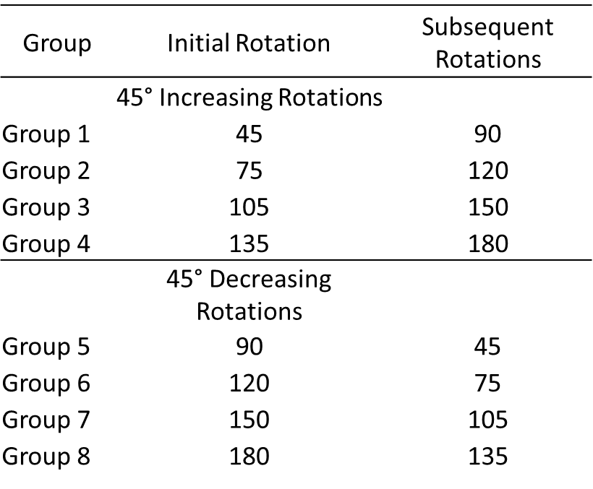
Do Abeele and Bock’s findings generalize to the laparoscopic environment?
Neilson et al., (2017)
Participants: 96 undergraduates
Apparatus: Laparoscopic training simulator
Participants were assigned to one of eight groups and performed a peg-transfer task

Slide 20
Do Abeele and Bock’s findings generalize to the laparoscopic environment?
Yes, they did…

Slide 21
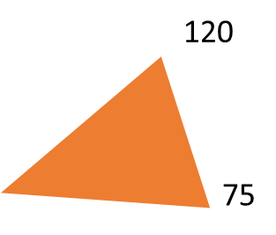
Are there different thresholds for increasing and decreasing rotations?
Is there one threshold (same for increasing and decreasing rotations, located in the overlapping area of the two ranges).
150
105

Slide 22
Subsidiary experiment
Participants were assigned to either the increasing or the decreasing condition.
Participants performed one transfer at each rotation
Increasing rotation: worst performance at 120°
Decreasing rotation: worst performance at 110°.
At first sight, it looks like the threshold for the increasing and the decreasing rotations
is identical, but is this conclusion consistent with our prior findings?

Slide 23
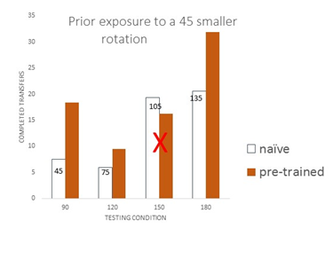
At first sight, it looks like the threshold for increasing and
decreasing rotations is identical (~110°-120°), but is this conclusion consistent with our prior findings?
With one threshold at ~110°-120°, these performance improvements should not have occurred.
Possibility: The threshold for increasing rotations might be at ~ 120°, while the threshold for decreasing rotations might be between 100° and 105°. However, our subsidiary experiment did not assess performance between 100° and 105°.

Slide 24
Conclusion
Adapting to disruptions of hand-eye mappings, like those experienced in the laparoscopic environment, are qualitatively different from performing mental rotations.
There might be different thresholds for increasing and decreasing rotations.
Future research:
Do these findings generalize to expert surgeons?

Slide 25
References
Abeele, S., & Bock, O. (2001). Sensorimotor adaptation to rotated visual input: Different mechanisms for small versus large rotations. Experimental Brain Research, 140(4), 407-410. doi:10.1007/s002210100846
Cunningham, H. A. (1989). Aiming error under transformed spatial mappings suggests a structure for visual-motor maps. Journal Of Experimental Psychology: Human Perception And Performance, 15(3), 493-506. doi:10.1037/0096-1523.15.3.493
Hedman, L., Ström, P., P. Andersson, P., Kjellin, A., Wredmark, T., & Felländer-Tsai, L. (2006). High-level visual-spatial ability for novices correlates with performance in a visual-spatial complex surgical simulator task. Surgical Endoscopy, 20, 1275–1280. doi: 10.1007/s00464-005-0036-6
Klein, M. I., Wheeler, N. J., & Craig, C. (2015). Sideways camera rotations of 90° and 135° result in poorer performance of laparoscopic tasks for novices. Human Factors, 57(2), 246-261. doi:10.1177/0018720814553027
Neilson, B. N. & Klein, M. I. (2017). Assessment of performance carry-over effects due to successive exposure to different lateral camera rotations in a laparoscopic training environment. Manuscript submitted for publication.
Shepard, R. N., & Metzler, J. (1971). Mental rotation of three-dimensional objects. Science, 171(3972), 701-703. doi:10.1126/science.171.3972.701

