Slide 1
Humanization of Robots: The Role of Group Membership
Presentation by Madeline Niichel

Slide 2
Purpose & Background
Treatment of robots – sometimes like humans, sometimes not
Anthropomorphism: projecting human-like qualities onto an object
Assume inverse of dehumanization
Legal implications
How we protect animals vs. how we protect robots
Practical Implications
Knowledge about treatment of robots will help us design them to better suit needs of society
Current study: group effects and treatment of robots

Slide 3
Purpose & Background
Two dimensions of anthrop.: Human Uniqueness and Human Nature (Haslam, 2006) – a.k.a. Haslam’s dual model scale
Human Uniqueness—separates humans from animals (civility, rationality, morality, maturity, etc.)
Human Nature—separates humans from machines (intuition, agency, spontaneity, emotional responsiveness etc.)
Group belonging—members of out-groups considered less human (Haslam & Loughnan, 2014)
Spurred current study

Slide 4
Method
Condition
Player 1 | Player 3
TTU_student | TTU_student
TTU_student | TTU_student
TTU_student | UT_student
UT_student | TTU_student
TTU_student | TTU_robot
TTU_robot | TTU_student
TTU_student | UT_robot
UT_robot | TTU_student
Eight conditions
Students and robots from University of Texas or Texas Tech University
Randomly assigned to one of eight conditions
Set up the program to toss ball 30 times—10 of which go to human player (participant)

Slide 5
Method
Condition
Player 1 | Player 3
TTU_student | TTU_student
TTU_student | TTU_student
TTU_student | UT_student
UT_student | TTU_student
TTU_student | TTU_robot
TTU_robot | TTU_student
TTU_student | UT_robot
UT_robot | TTU_student
Testing
Informed consent and instructions
Initial questions regarding robots (Qualtrics)
Likelihood to anthropomorhpize
Participant plays Cyberball
Questions about other players & demographics
Debriefed and Dismissed

Slide 6
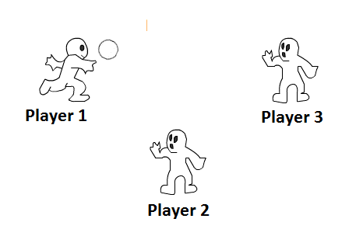
Method
Cyberball In Action

Slide 7
Expected Results and Practical Importance
Results will give insight into which dimensions are affected
Results based on tosses to other players and evaluation of other players
Expectation: Group membership affects mostly the Human Uniqueness dimension (animalistic)
Group Effects: Student vs. Robot, and TTU vs. UT
Looking at interactions among above
Practical Importance
If the manipulations work in this context, we will be better able to leverage the literature about dehumanization to make predictions about how people may interact with robots

Slide 8
References
Haslam, N. & Loughnan, S. 2014. Dehumanization and Infrahumanization. Annual
Review of Psychology, 65, 399-423.
Haslam, N. 2006. Dehumanization: An Integrative Review. Personality and Social
Psychology Review, 10, 252-264.

