Slide 1
Suicidal Ideation and Planning Among Young Adults who Acknowledge Sexual Orientation Self-Concept Ambiguity
Amelia E. Talley, Ph.D.
Jennifer J. Muehlenkamp, Ph.D.
David W. Hancock, M.A.
Courtney L. Bagge, Ph.D.
NSF – REU Program
Texas Tech University
June 13, 2017

Slide 2
It Gets Better?
Project began in 2010 in response to LGBT+ suicides after being bullied at school.
N = 50,000 user-created videos
Notable contributors: President Obama; Adam Lambert; Joe Jonas; Ellen DeGeneres; Facebook; Pixar
50,000,000+ Views
Left-to-Right:
Billy Lucas, Seth Walsh, Raymond Chase

Slide 3
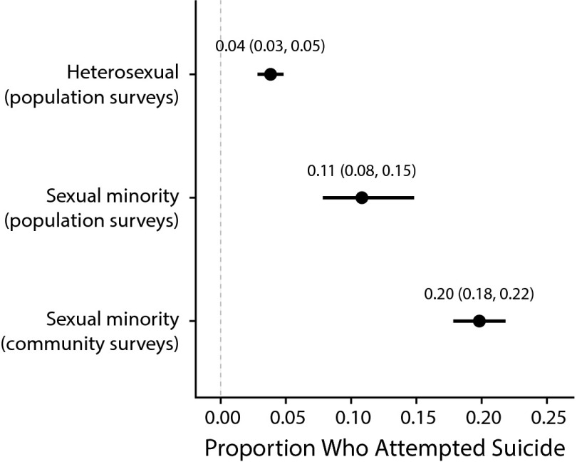
Sexual Minority Suicide disparities
Lesbian, gay, and bisexual (LGB) people are at higher risk of suicidal behavior than heterosexual people (Hottes et al., 2016; Plöderl et al., 2014; Russell, 2003).
e.g., suicidal thoughts, plans, and attempts
Notes:
Compared to their heterosexual counterparts, lesbian, gay, and bisexual individuals are at greater risk of suicidal behavior.
Meta-analyses have shown that approximately 11% of LGB individuals in population based surveys will attempt suicide at least once in their lifetime. In community samples, this estimate jumps to 20%.

Slide 4
Sexual Minority Suicide disparities
 |  |  | Suicide ideation |  | Suicide Plans
Female |  | N = 24,212 | Odds Ratio | 95% CI | Odds Ratio | 95% CI
Sexual identity
 | Heterosexual |  | 1.00 | Ref | 1.00 | Ref
 | Lesbian |  | 3.14*** | 1.97, 5.03 | 2.71*** | 1.46, 5.02
 | Bisexual |  | 4.16*** | 3.37, 5.15 | 4.10*** | 3.14, 5.36
 | Unsure |  | 2.15*** | 1.60, 2.89 | 2.27*** | 1.57, 3.27
***p < .001
***p < .001
(Stone et al., 2014)
Notes:
For female youth, there is a disparity in terms of suicidal ideation and planning based on sexual identity. Specifically, Lesbian and Bisexual youth have greater odds of reporting ideation and plans than heterosexual youth. Indeed, even female adolescents who report being unsure of their sexual identity are at heightened risk.

Slide 5
Sexual Minority Suicide disparities
 |  |  | Suicide ideation |  | Suicide Plans
Male |  | N = 21,874 | Odds Ratio | 95% CI | Odds Ratio | 95% CI
Sexual identity
 | Heterosexual |  | 1.00 | Ref | 1.00 | Ref
 | Gay |  | 3.40*** | 2.19, 5.28 | 2.06*** | 1.20, 3.56
 | Bisexual |  | 4.89*** | 3.50, 6.82 | 5.11*** | 3.16, 8.25
 | Unsure |  | 2.73*** | 1.94, 3.83 | 2.48*** | 1.65, 3.75
***p < .001
***p < .001
(Stone et al., 2014)
Notes:
For male youth, there is a similar disparity for suicidal ideation and planning based on sexual identity. Specifically, Gay, Bisexual, and even adolescents who are unsure of their sexual identity have greater odds of reporting ideation and plans than heterosexual adolescents.

Slide 6
Moving Beyond LGB Identity as a Risk Factor
Identity
Do you consider yourself gay, lesbian, bisexual, straight, queer?
Sexual identity, attraction, behavior are primary facets that comprise one’s sexual orientation (Laumann et al., 1996).
Sexual orientation dimensions, at times, may be incongruent for various reasons.
Behavior
Do you have sex with men?
women?
both? all?
Attraction
What gender(s) are you attracted to: men?
women?
both? all?
Source: Riley, 2015
Notes:
Individuals who describe their sexual identity as “unsure” are at risk of suicide.
Wichstrøm and Hegna (2003) posited that individuals who are nonexclusive, questioning, or unsure of their sexual orientation may be at greater risk for suicidal behavior due to increased emotional distress and identity confusion that results from greater awareness of homoerotic attractions, negative disclosure experiences, and encounters with victimization (see also Hershberger, Pilkington, & D’Augelli, 1997).
Sexual orientation dimensions, at times, may be incongruent for various reasons.
Bisexual identity
“Unsure” or transitioning identity
Heightened sexual fluidity

Slide 7
Moving Toward Identity-related Characteristics as Risk Factors
Sexual Self-Concept Ambiguity is defined as “the extent to which dimensions of sexual orientation are ill-defined, unstable, or inconsistent within and over time.”
Hypothesized identity-related contributor to sexual minority health disparities
(Talley & Littlefield, 2014; Talley & Stevens, 2015)
Awareness of self-relevant discrepancies contributes to heightened negative affect and aversive self-focus.
“My beliefs and actions regarding my sexual orientation often seem contradictory.”
Notes:
Individuals who describe their sexual identity as “unsure” are at risk of suicide.

Slide 8
Moving Toward Identity-related Characteristics as Risk Factors
Sexual self-concept ambiguity has been shown to relate to:
Identity uncertainty/confusion
Depression & anxiety symptoms
Alcohol Use Disorder symptoms
Sexual exploration motives
Active suicidal ideation
Notes:
Individuals who describe their sexual identity as “unsure” are at risk of suicide.

Slide 9
Interpersonal Theory of Suicide Risk
Thwarted Belongingness
“I am alone.”
Perceived Burdensomeness
“I am a burden.”
Desire for Suicide

Slide 10
Interpersonal Theory of Suicide Risk
Thwarted Belongingness
“I am alone.”
Perceived Burdensomeness
“I am a burden.”
Suicide or near-lethal suicide attempt.
Capability for Suicide
“I am not afraid to die.”

Slide 11
Relevant Background
N = 349 women
Age: M=20.93, SD=2.92
Online survey
SSA items: 1-4 scale
“Sometimes I feel that my sexual orientation is not really what it appears to be.”
Notes:
Ethnicity/Race
White/Caucasian: 84%
Black/African-American: 10.8%
Asian/Pacific Islander: 4.8%
Hispanic/Latina: 4.6%
Current sexual identity
Exclusively heterosexual: 58% (n = 203)
Primarily heterosexual: 20.2% (n = 71)
Equally lesbian and heterosexual (e.g., “bisexual): 6.3% (n = 22)
Primarily lesbian or gay: 2.8% (n = 10)
Exclusively lesbian or gay: 7.4% (n = 26)
Questioning/unlabeled: 2.0% (n = 7); Queer: 2.6% (n = 9); “Other”: 0.6% (n = 2)

Slide 12
Relevant Background
Thwarted Belongingness
“I am alone.”
.58†
Sexual Self-Concept Ambiguity
.43***
.57***
-.37*
Recent thoughts of ending your life?
Yes/No
.004
.45***
Perceived Burdensomeness
“I am a burden.”
MODEL FIT STATISTICS
χ2 (246) = 486.60, p < .001 RMSEA = .05, 95% CI: .05,.00
CFI = 0.93
TLI = 0.92
SRMR = .06
1.81***
Notes:
Model adjusted estimates for sexual identity status and depression scores.
Talley et al. (2015)
Fifteen percent of the current sample reported nonzero levels of active suicide ideation in the past 2 weeks.
Sexual Self-Concept Ambiguity (α = .95)
“Sometimes I feel that my sexual orientation is not really what it appears to be.”
Perceived Burdensomeness
Self-esteem Scale (Rosenberg, 1965)
Hopkins Symptom Checklist (HSC: Derogatis et al., 1974): “feelings of worthlessness,” “feelings of blame”
PANAS (Watson et al., 1998): Ashamed, Guilty, Irritable, Hostile
Thwarted Belongingness
HSC: “feeling lonely”
Number of close fe(male) friends
Social Interaction Anxiety (Mattick & Clarke, 1998): “When mixing socially, I am uncomfortable.”
Hopelessness – HSC “Feeling hopeless about the future”
Suicidal Ideation: Yes/No
Was participant bothered by “thoughts about ending your life” in the past 2 weeks?

Slide 13
Relevant Background
Notes:
Marginal effect (p = .07, one way)showing highest levels of ideation for those high in both TB and PB relative to those high in PB and low in TB.

Slide 14
Relevant Background
Young adult women who acknowledge apparent contradictions among sexual orientation facets report heightened feelings of being a burden to others (i.e., perceived burdensomeness) and a lack of supportive relationships (i.e., thwarted belongingness).
Sexual self-concept ambiguity may increase risk of active suicidal ideation via thwarted belongingness (TB) and perceived burdensomeness (PB), particularly among sexual minority women who feel a sense of hopelessness about the future.

Slide 15
Current Hypotheses
Thwarted belongingness (TB) and perceived burdensomeness (PB) will: (a) interact to predict heightened risk of current suicidal ideation; (b) account for the relation between SSA and current suicidal ideation (Talley, Brown, Cukrowicz, & Bagge, 2015).
Hopelessness will: (a) directly relate to current suicidal ideation; (b) function as a proximal mediator of associations among SSA, TB, PB, and current suicidal ideation (Van Orden et al., 2010).

Slide 16
Current Hypotheses
Fearlessness about death, a component of acquired capability for suicide, will interact with active suicidal desire to exacerbate the association between active suicidal ideation and past-year suicidal planning.

Slide 17
Method
Participants
Young-adult college attendees from the northern U.S. (n = 364), ages 18-to-37 (M = 20.0; SD = 2.0), completed a cross-sectional, online, anonymous survey.
80% Female
95% White
Median Household Income = $51,000-$100,000
Notes:
Students were recruited using an online study board (SONA) housed within the psychology department. All students in the psychology department have access and can voluntarily participate in a number of different studies. This one was one of many. The surveys were completed online and were anonymous (we have a set up in place so students have random digit ID # to access studies so researchers cannot access names).

Slide 18
Method
Measures
Sexual Self-Concept Ambiguity (SSA; Talley & Stevens, 2015)
Interpersonal Needs Questionnaire (INQ; Van Orden et al., 2009)
Hopelessness: UTSA Future Disposition Inventory (UTSA-FDI; Osman et al., 2010)
Modified Scale of Suicidal Ideation (MSSI; Joiner et al., 1997)
Acquired Capability for Suicide Scale - Fearlessness About Death (ACSS-FAD; Robeiro et al., 2014)
Past Year Suicide Plan – Single-item; Y/N
Notes:
MSSI was past two weeks.

Slide 19
Sexual Self-Concept Ambiguity (M = 1.30; SD = .73; n = 356)
14%
(n = 43) reported elevated SSA scores
n=4
n=2
n=5
n=43
n=298

Slide 20
Does SEXUAL SELF-CONCEPT AMBIGUITY RELATE TO SUICIDE BEHAVIORS?
Bivariate Relationship
Sexual self-concept ambiguity (SSA) is positively correlated with:
current suicidal ideation, r = .21, p < .001,
past-year suicidal planning, r = .10, p = .07.

Slide 21
Results
Thwarted Belongingness
Acquired Capability -FAD
.81**
Sexual Self-Concept Ambiguity
Hopeless
Suicidal Ideation
PY Suicide Plan
Perceived Burdensomeness
Notes:
Sexual self-concept ambiguity scores were positively correlated with levels of suicidal ideation (Spearman’s ρ = .21, p < .001) and number of lifetime suicide attempts (Spearman’s ρ = .14, p < .01).
Results replicated previous interaction between levels of PB and TB in their association with active suicidal ideation, b = .036, SE = 0.01, p < .001.
Acquired capability for suicide, reflected in fearlessness of death, was the most proximal associate of lifetime number of suicide attempts, b = 0.81, SE = 0.30, p = .008.
Active suicidal ideation was related to a higher expected count of lifetime number of suicide attempts, via acquired capability for suicide, IE = .58, SE = .36, p = .09, one-tailed.

Slide 22
Results
Thwarted Belongingness
.01
Acquired Capability -FAD
.11***
.35***
.81**
.55***
.06***
Hopeless
Sexual Self-Concept Ambiguity
.12***
-.01
Suicidal Ideation
PY Suicide Plan
.04***
.13***
.40***
.03
Perceived Burdensomeness
*p < .05
**p < .01
***p < .001
Model estimates are adjusted for respondent age, gender, and DASS Depression scores.
Notes:
Sexual self-concept ambiguity scores were positively correlated with levels of suicidal ideation (Spearman’s ρ = .21, p < .001) and number of lifetime suicide attempts (Spearman’s ρ = .14, p < .01).
Results replicated previous interaction between levels of PB and TB in their association with active suicidal ideation, b = .036, SE = 0.01, p < .001.
Acquired capability for suicide, reflected in fearlessness of death, was the most proximal associate of lifetime number of suicide attempts, b = 0.81, SE = 0.30, p = .008.
Active suicidal ideation was related to a higher expected count of lifetime number of suicide attempts, via acquired capability for suicide, IE = .58, SE = .36, p = .09, one-tailed.

Slide 23
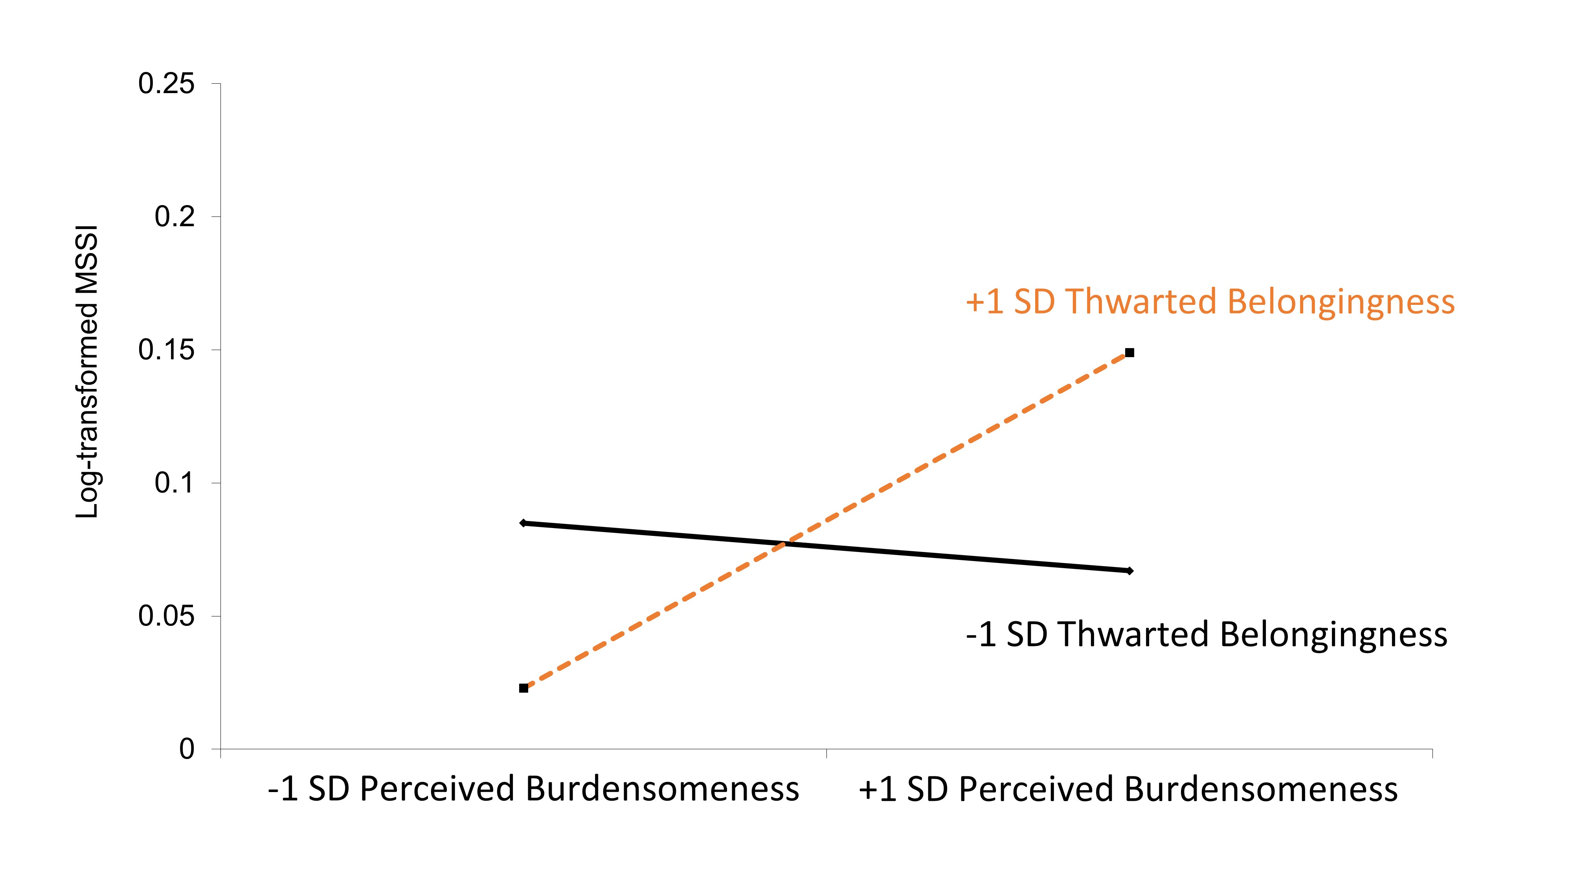
PB X TB → Active Suicidal Ideation (MSSI)

Slide 24
Results
Replication:
Levels of PB and TB interacted to active predict suicidal ideation, b = .035, SE = 0.01, p < .001.
PB, TB, and Hopelessness were serial mediators of the association between sexual self-concept ambiguity and suicide ideation.
SSA→PB→Hopelessness→MSSI, IE = .004, SE = .002, p = .009
SSA→TB→Hopelessness→MSSI, IE = .006, SE = .003, p = .013
Notes:
Sexual self-concept ambiguity scores were positively correlated with levels of suicidal ideation (Spearman’s ρ = .21, p < .001) and number of lifetime suicide attempts (Spearman’s ρ = .14, p < .01).
Results replicated previous interaction between levels of PB and TB in their association with active suicidal ideation, b = .036, SE = 0.01, p < .001.
Acquired capability for suicide, reflected in fearlessness of death, was the most proximal associate of lifetime number of suicide attempts, b = 0.81, SE = 0.30, p = .008.
Active suicidal ideation was related to a higher expected count of lifetime number of suicide attempts, via acquired capability for suicide, IE = .58, SE = .36, p = .09, one-tailed.

Slide 25
Results
Thwarted Belongingness
Acquired Capability -FAD
.48
.11***
.01
.81**
.55***
.35***
-.20
.04***
.01
.06***
-1.31*
1.52†
Sexual Self-Concept Ambiguity
Hopeless
.12***
PY Suicide Plan
-.01
Suicidal Ideation
2.74
-.16
.13***
.40***
.03
1.01*
Perceived Burdensomeness
†p < .10
*p < .05
**p < .01
***p < .001
Model estimates are adjusted for respondent age, gender, and DASS Depression scores.
Notes:
Active suicidal ideation was related to a higher expected count of lifetime number of suicide attempts, via acquired capability for suicide, IE = .58, SE = .36, p = .09, one-tailed.

Slide 26
Results
Fearlessness about death marginally interacted with active suicidal ideation to predict suicidal planning in the prior year, b = 1.53, SE = 0.89, p = .087.
+1 SD Fearlessness
about Death
-1 SD Fearlessness
about Death
Notes:
Sexual self-concept ambiguity scores were positively correlated with levels of suicidal ideation (Spearman’s ρ = .21, p < .001) and number of lifetime suicide attempts (Spearman’s ρ = .14, p < .01).
Results replicated previous interaction between levels of PB and TB in their association with active suicidal ideation, b = .036, SE = 0.01, p < .001.
Acquired capability for suicide, reflected in fearlessness of death, was the most proximal associate of lifetime number of suicide attempts, b = 0.81, SE = 0.30, p = .008.
Active suicidal ideation was related to a higher expected count of lifetime number of suicide attempts, via acquired capability for suicide, IE = .58, SE = .36, p = .09, one-tailed.

Slide 27
Take Home Points
Sexual self-concept ambiguity is a risk factor for current suicidal ideation (Talley, Brown, Cukrowicz, & Bagge, 2015).
Explained by feelings of burdensomeness, social isolation, and hopelessness
Preliminary results suggest fearlessness about death may exacerbate the positive association between active suicidal ideation and likelihood of suicide planning.
Notes:
Sexual self-concept ambiguity was shown to be an identity-related risk factor of active suicidal ideation.
Explained by feelings of being a burden to others and a perceived lack of supportive relationships, which, in turn, overlapped with feelings of hopelessness about the future - a robust predictor of active suicide ideation.
Indirect effects suggest that active suicidal ideation may relate to a greater number of lifetime suicide attempts based on overlap with fearlessness about death.

Slide 28
Limitations
Limited Generalizability
Participants were primarily White, college-attending females
Non-clinical sample
Concerted focus on young adulthood
Self-report, retrospective, cross-sectional data
Retrospective bias and forgetting
No causal relations can be determined
Notes:
Archival studies are challenging for LGB populations

Slide 29
Thanks!!
Collaborators
Jennifer J. Muehlenkamp, PhD (University of Wisconsin- Eau Claire)
Courtney L. Bagge, PhD (University of Mississippi Medical Center)
David W. Hancock, MA (Texas Tech University)
Sarah Brown, MA (Texas Tech University)
Kelly Cukrowicz, PhD (Texas Tech University)
NIH R00 AA001974

Slide 30
Comments or Questions???

